Slide 1

CIS 467 :Data Mining
Department of Information Systems
Faculty of Information Technology and Computer Sciences
Yarmouk University – Jordan
Notes:
1

Slide 2
Topic 2 (1) Getting to Know your Data (Data Exploration)

Slide 3
Topics
Introduction and Motivation
Data Objects and Attribute Types
Basic Statistical Descriptions of Data
Data Visualization
Measuring Data Similarity and Dissimilarity
Summary

Slide 4
Introduction
It’s tempting to jump straight into mining, but first, we need to get the data ready. This involves having a closer look at attributes and data values.
Real-world data are typically noisy, enormous in volume (often several gigabytes or more), and may originate from a heterogeneous sources.
This topic is about getting familiar with your data. Knowledge about your data is useful for data preprocessing, the first major task of the data mining process.
You will want to know the following: What are the types of attributes or fields that make up your data? What kind of values does each attribute have? Which attributes are discrete, and which are continuous-valued? What do the data look like?

Slide 5
Motivation: Why to know the data first
Data Exploration
Basic statistical descriptions can be used to learn more about each attribute’s values.
Given an attribute we can determine its: mean (average value), median (middle value), and mode (most common value).
These are measures of central tendency, which give us an idea of the “middle” or center of distribution.
Knowing such basic statistics regarding each attribute makes it easier to fill in missing values, smooth noisy values, and spot outliers during data preprocessing.
Knowledge of the attributes and attribute values can also help in fixing inconsistencies incurred during data integration.

Slide 6
2.1 Data Objects
Data sets are made up of data objects.
A data object represents an entity.
Examples:
sales database: customers, store items, sales
medical database: patients, treatments
university database: students, professors, courses
Also called samples , examples, instances, data points, objects, tuples.
Data objects are described by attributes.
In Database:
rows -> data objects;
columns ->attributes.

Slide 7
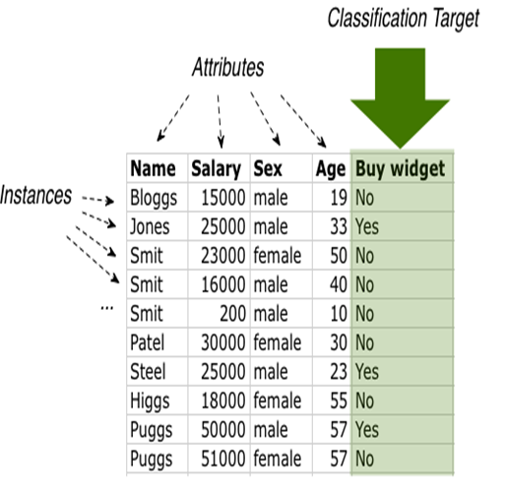
Attributes
Attribute is a data field, representing a characteristic or
feature of a data object.
E.g. →
Other Names: dimensions,
features,
variables,
column.

Slide 8
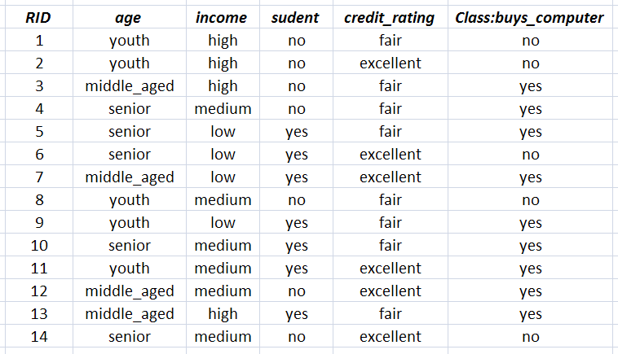
Example of a Flat Dataset
The Buys Computer Dataset: This follows an example from Quinlan’s ID3

Slide 9
Attribute Types
Nominal: categories, states, or “names of things”
Hair_color = {auburn, black, blond, brown, grey, red, white}
marital status, occupation, ID numbers, zip codes
Binary
Nominal attribute with only 2 states (0 and 1)
Symmetric binary: both outcomes equally important
e.g., gender
Asymmetric binary: outcomes not equally important.
e.g., medical test (positive vs. negative)
Convention: assign 1 to most important outcome (e.g., HIV positive)
Ordinal
Values have a meaningful order (ranking) but magnitude between successive values is not known.
Size = {small, medium, large}, grades, army rankings

Slide 10
Numeric Attribute Types
Quantity (integer or real-valued)
Interval
Measured on a scale of equal-sized units
Values have order
E.g., temperature in C˚or F˚, calendar dates
No true zero-point
Ratio
Inherent zero-point
We can speak of values as being an order of magnitude larger than the unit of measurement (10 K˚ is twice as high as 5 K˚).

Slide 11
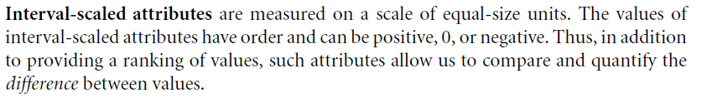
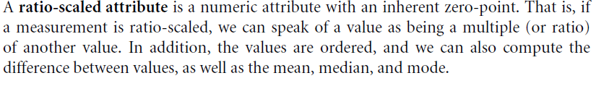
From Book

Slide 12
Discrete vs. Continuous Attributes
Discrete Attribute
Has only a finite or countably infinite set of values
E.g., zip codes, profession, or the set of words in a collection of documents
Sometimes, represented as integer variables
Note: Binary attributes are a special case of discrete attributes
Continuous Attribute
Has real numbers as attribute values
E.g., temperature, height, or weight
Practically, real values can only be measured and represented using a finite number of digits
Continuous attributes are typically represented as floating-point variables

Slide 13
Basic Statistical Descriptions of Data
Motivation
For data preprocessing to be successful, it is essential to have an overall picture of your data.
Basic statistical descriptions can be used to identify properties of the data and highlight which data values should be treated as noise or outliers.
To better understand the data: central tendency, variation and spread
Data dispersion characteristics
median, max, min, quantiles, outliers, variance, etc.
Numerical dimensions correspond to sorted intervals
Data dispersion: analyzed with multiple granularities of precision
Boxplot or quantile analysis on sorted intervals
Dispersion analysis on computed measures
Folding measures into numerical dimensions
Boxplot or quantile analysis on the transformed cube

Slide 14
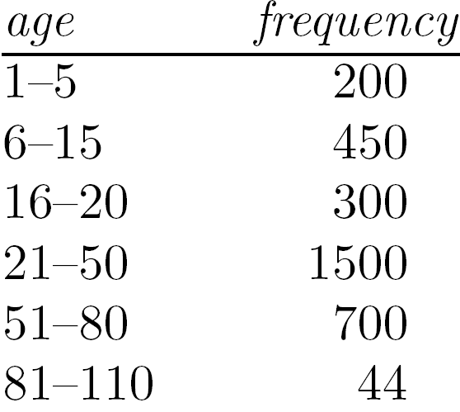
Measuring the Central Tendency
Mean (algebraic measure) (sample vs. population):
Note: n is sample size and N is population size.
Weighted arithmetic mean:
Trimmed mean: chopping extreme values
Median:
Middle value if odd number of values, or average of the middle two values otherwise
Estimated by interpolation (for grouped data):
Mode
Value that occurs most frequently in the data
Unimodal, bimodal, trimodal
Empirical formula:

Slide 15
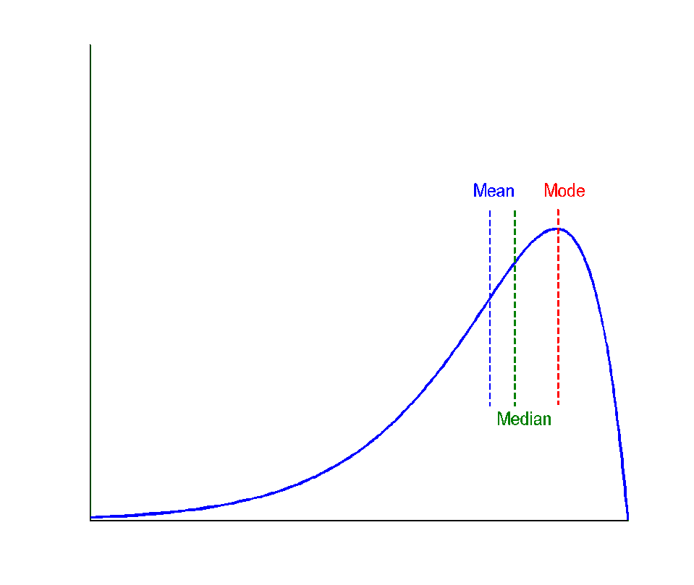
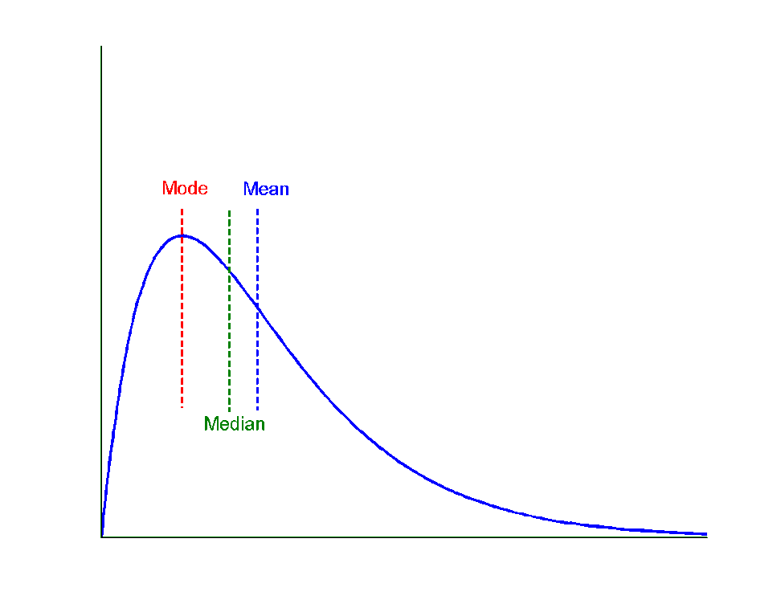
Symmetric vs. Skewed Data
Median, mean and mode of symmetric, positively and negatively skewed data
symmetric
positively skewed
negatively skewed
15

Slide 16
Measuring the Dispersion of Data
Variance and standard deviation (sample: s, population: σ)
Variance: (algebraic, scalable computation)
Standard deviation s (or σ) is the square root of variance s² ⁽or σ²⁾

Slide 17
Positively and Negatively Correlated Data
The left half fragment is positively correlated
The right half is negative correlated

Slide 18
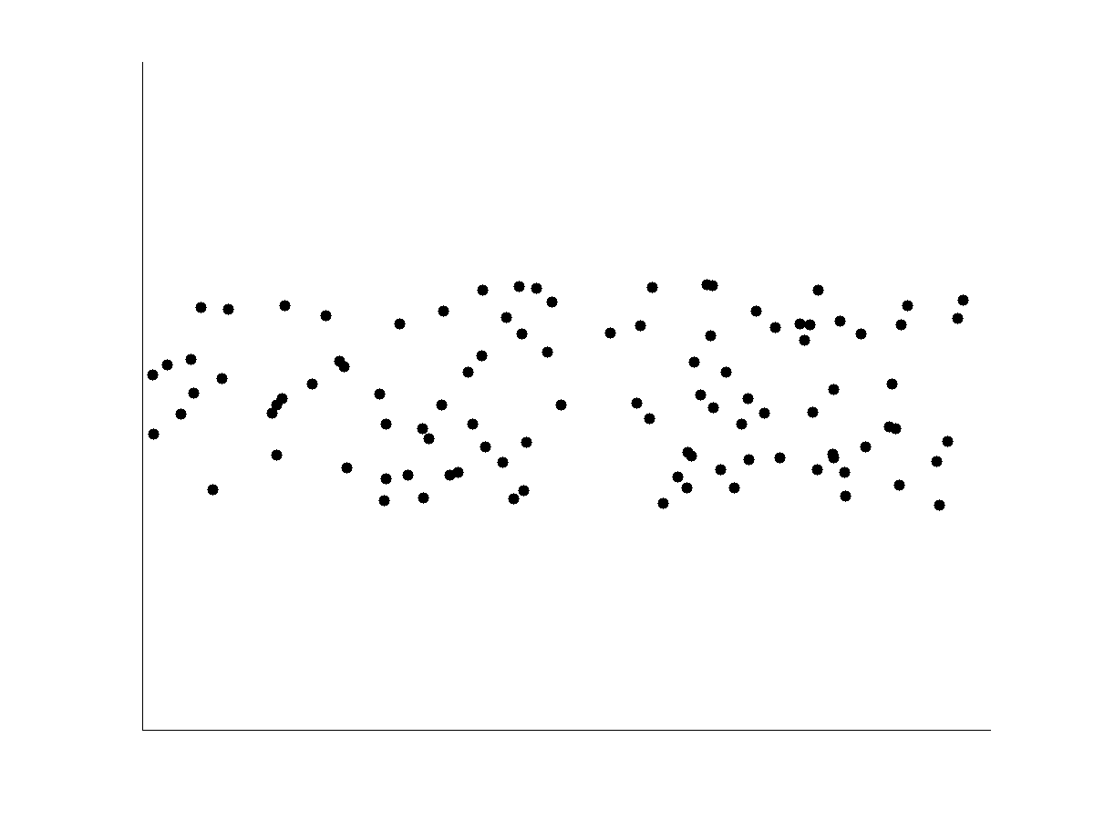
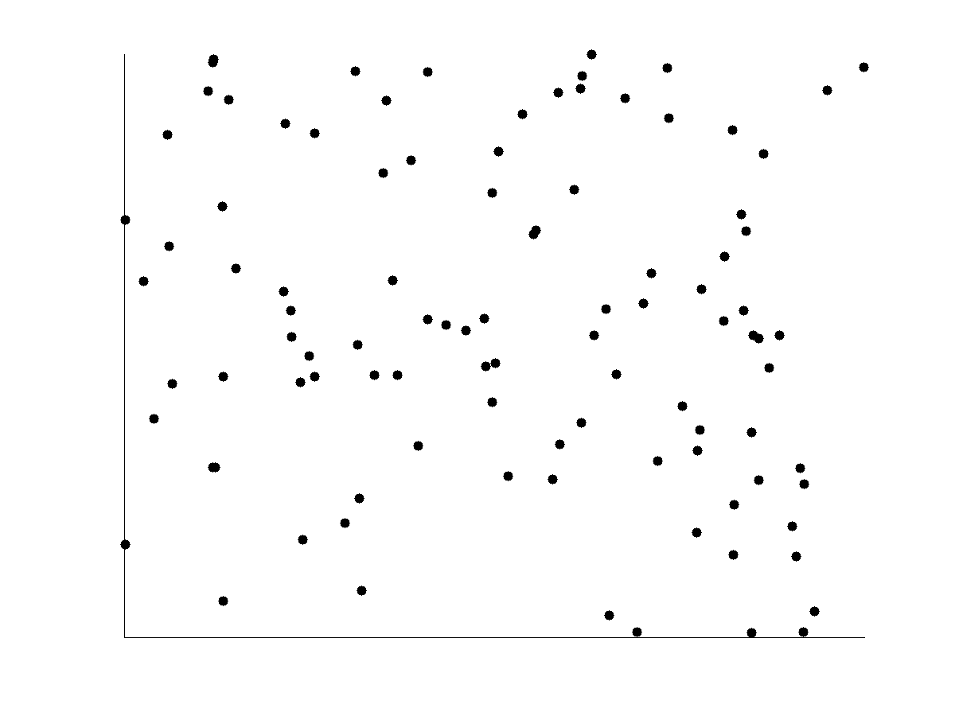
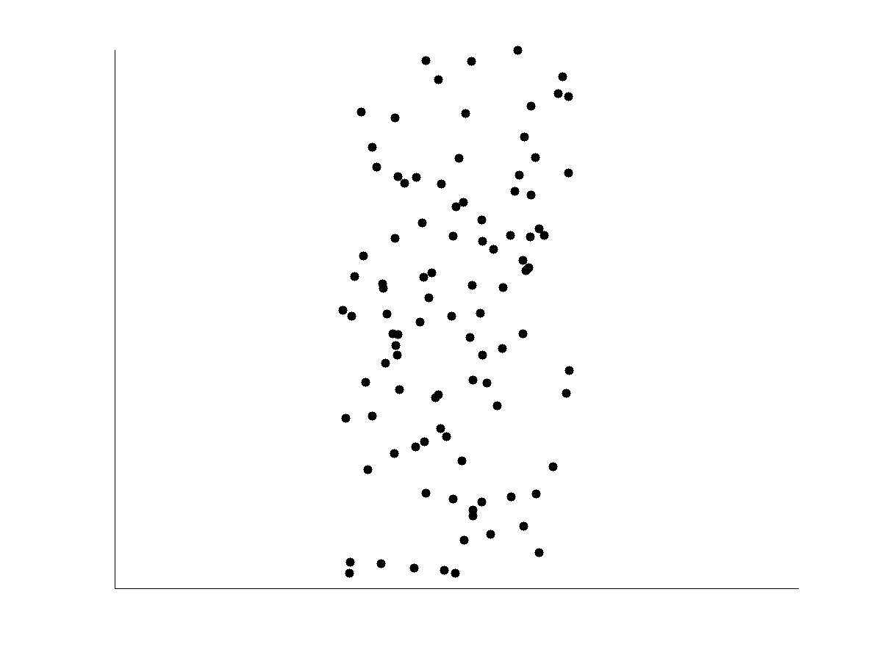
Uncorrelated Data

Slide 19
Similarity and Dissimilarity
Similarity
Numerical measure of how alike two data objects are
Value is higher when objects are more alike
Often falls in the range [0,1]
Dissimilarity (e.g., distance)
Numerical measure of how different two data objects are
Lower when objects are more alike
Minimum dissimilarity is often 0
Upper limit varies
Proximity refers to a similarity or dissimilarity for Ordinal attributes

Slide 20
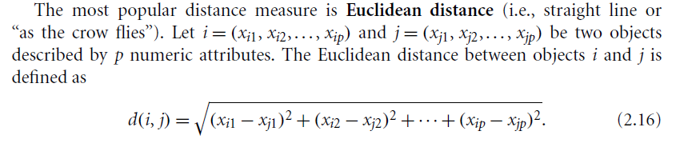

Similarity

Slide 21
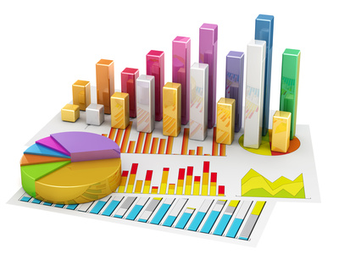
Data Visualization
Why data visualization?
Gain insight into an information space by mapping data onto graphical primitives
Provide qualitative overview of large data sets
Search for patterns, trends, structure, irregularities, relationships among data
Help find interesting regions and suitable parameters for further quantitative analysis
Provide a visual proof of computer representations derived
Categorization of visualization methods:
Pixel-oriented visualization techniques
Geometric projection visualization techniques
Icon-based visualization techniques
Hierarchical visualization techniques
Visualizing complex data and relations

Slide 22

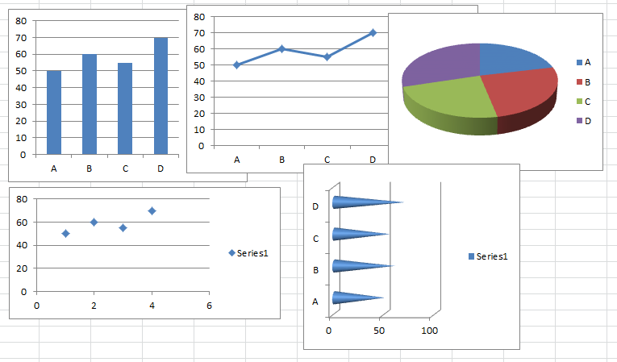
Simple Data Visualization using Excel

Slide 23




Think and Discuss
Discuss how and where we can use the Visualization concepts for the three phases of Knowledge Discovery (KDD) Process.?
Preprocessing Phase
Data Mining Phase
Post Processing Phase

Slide 24

Statistics Tools
Students are encouraged to practice data exploration using one of these tools:
SPSS
Excel
SAS
R
PYTHON
Don’t fear, just try One

Slide 25

Exercise
Given the following numbers that represent students' grades in a given course, find the following:
90, 85, 75, 45, 95, 66, 74, 83, 66, 57
Arithmetic Mean
Trimmed Mean
Mode
Variance
Median
Standard Deviation
Range
Plot the grades using Line Chart
Use Excel/SPSS to find all previous metrics.
Write your own notes

Slide 26
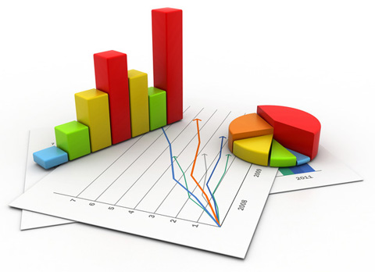

Exercise
Given the following numbers that represent students grades in a given course, find the following:
85, 85, 85, 85, 85, 85, 85, 85, 85, 85
Arithmetic Mean
Trimmed Mean
Mode
Variance
Median
Standard Deviation
Range
Plot the grades using Line Chart
Use Excel/SPSS to find all previous metrics.
Write your own notes

Slide 27
Break for FUN: Amazing mathematics
If: A B C D E F G H I J K L M N O P Q R S T U V W X Y Z =
1 2 3 4 5 6 7 8 9 10 11 12 13 14 15 16 17 18 19 20 21 22 23 24 25 26
Then
H+A+R+D+W+O+R+K ; 8+1+18+4+23+15+18+11=98%
K+N+O+W+L+E+D+G+E ; 11+14+15+23+12+5+4+7+5=96%
L+O+V+E; 12+15+22+5 = 54%
L+U+C+K ; 12+21+3+11 = 47%
None of them makes 100%. Then what makes 100% ???
Is it Money? NO !!!
M+O+N+E+Y= 13+15+14+5+25=72%
Leadership? NO !!!
L+E+A+D+E+R+S+H+I+P= 12+5+1+4+5+18+19+8+9+16=97%
Every problem has a solution, only if we perhaps change our "ATTITUDE".
A+T+T+I+T+U+D+E ; 1+20+20+9+20+21+4+5 = 100%
It is therefore OUR ATTITUDE towards Life and Work that makes OUR Life 100% Successful..

Slide 28
Topic 2 (2) Data Preprocessing
28

Slide 29
Topics
Data Preprocessing: An Overview
Data Quality
Major Tasks in Data Preprocessing
Data Cleaning
Data Integration
Data Reduction
Data Transformation and Data Discretization
Summary
29

Slide 30
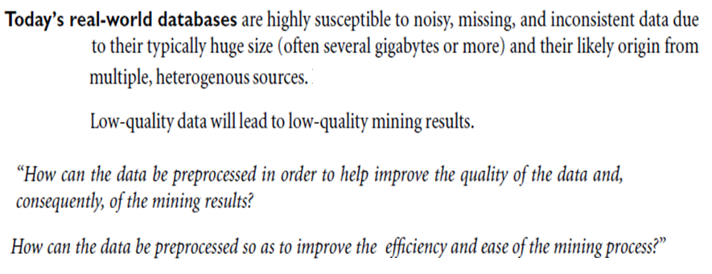
Data Preprocessing

Slide 31
Data Quality: Why Preprocess the Data?
Data in the Real World is Dirty ( GIGO ………)
Measures for data quality: A multidimensional view
Accuracy: correct or wrong, accurate or not
Completeness: not recorded, unavailable, …
Consistency: some modified but some not, dangling, …
Timeliness: timely update?
Believability: how trustable the data are correct?
Interpretability: how easily the data can be understood?

Slide 32
Major Tasks in Data Preprocessing
Data cleaning
Fill in missing values, smooth noisy data, identify or remove outliers, and resolve inconsistencies
Data integration
Integration of multiple databases, data cubes, or files
Data reduction
Dimensionality reduction
Numerosity reduction
Data compression
Data transformation and data discretization
Normalization
Concept hierarchy generation

Slide 33
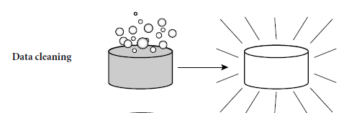
Data Cleaning
Data in the Real World Is Dirty: Lots of potentially incorrect data, e.g., instrument faulty, human or computer error, transmission error
incomplete: lacking attribute values, lacking certain attributes of interest, or containing only aggregate data
e.g., Occupation=“ ” (missing data)
noisy: containing noise, errors, or outliers
e.g., Salary=“−10” (an error)
inconsistent: containing discrepancies in codes or names, e.g.,
Age=“42”, Birthday=“03/07/2010”
Was rating “1, 2, 3”, now rating “A, B, C”
discrepancy between duplicate records
Intentional (e.g., disguised missing data)
Jan. 1 as everyone’s birthday?

Slide 34
Incomplete (Missing) Data
Data is not always available
E.g., many tuples have no recorded value for several attributes, such as customer income in sales data
Missing data may be due to
equipment malfunction
inconsistent with other recorded data and thus deleted
data not entered due to misunderstanding
certain data may not be considered important at the time of entry
not register history or changes of the data
Missing data may need to be inferred …..

Slide 35
How to Handle Missing Data?
1. Ignore the tuple: This is usually done when the class label is missing: (assuming the mining task involves classification). This method is not very effective, unless the tuple contains several attributes with missing values. It is especially poor when the percentage of missing values per attribute varies considerably.
2. Fill in the missing value manually: In general, this approach is time-consuming and may not be feasible given a large data set with many missing values.
3. Use a global constant to fill in the missing value: Replace all missing attribute values by the same constant, such as a label like “Unknown” or ??. If missing values are replaced by, say, “Unknown,” then the mining program may mistakenly think that they form an interesting concept, since they all have a value in common—that of “Unknown.” Hence, although this method is simple, it is not foolproof.
4. Use the attribute mean to fill in the missing value: For example, suppose that the average income of AllElectronics customers is $56,000. Use this value to replace the missing value for income.
5. Use the attribute mean for all samples belonging to the same class as the given tuple (Stratified Mean): For example, if classifying customers according to credit risk, replace the missing value with the average income value for customers in the same credit risk category as that of the given tuple.
6. Use the most probable value to fill in the missing value: This may be determined with regression, inference-based tools using a Bayesian formalism, or decision tree induction. For example, using the other customer attributes in your data set, you may construct a decision tree to predict the missing values for income.
7. Use a domain specific method.
Optional Assignment: Write a program that implement these methods.

Slide 36
Exercise
Fill in the missing values (??X and ??Y) using the following methods.
Attribute Mean
Stratified Attribute Mean
Global Constant
Use Linear Regression (Wait)
A1 | A2 | Class
10 | 650 | Yes
12 | 150 | No
15 | 200 | No
20 | 200 | Yes
??X | 350 | Yes
9 | 400 | Yes
5 | 500 | No
19 | ??Y | No
17 | 100 | Yes
16 | 300 | Yes

Slide 37
Noisy Data
Noise: random error or variance in a measured variable
Incorrect attribute values may be due to
faulty data collection instruments
data entry problems
data transmission problems
technology limitation
inconsistency in naming convention
Other data problems which require data cleaning
duplicate records
incomplete data
inconsistent data
37
Notes:
37

Slide 38

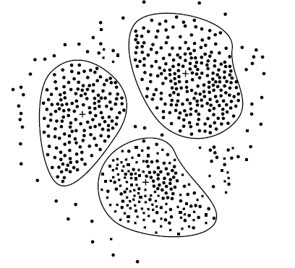
How to Handle Noisy Data?
Binning
first sort data and partition into (equal-frequency) bins
then one can
smooth by bin means,
smooth by bin median,
smooth by bin boundaries, etc.
Regression
smooth by fitting the data into regression functions
Clustering
detect and remove outliers
Combined computer and human inspection
detect suspicious values and check by human (e.g., deal with possible outliers)

Slide 39
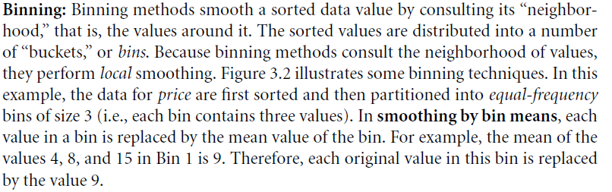
Binning

Slide 40
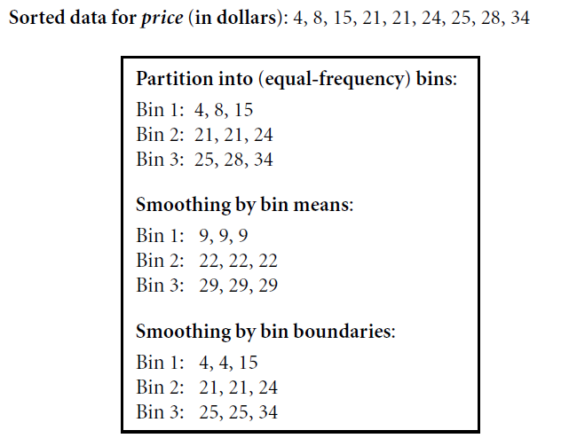
Example: Binning

Slide 41
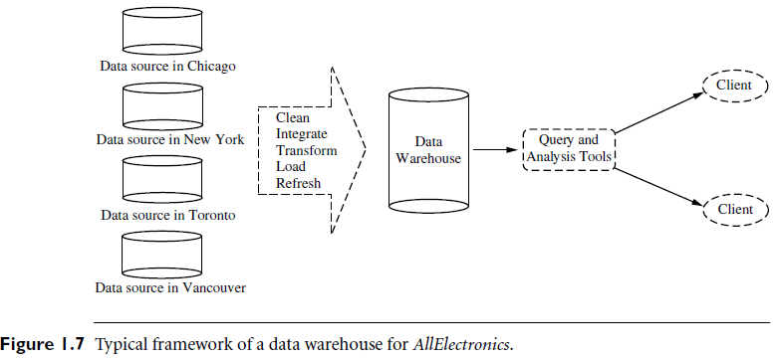
Data Preprocessing to build a Data Warehouse

Slide 42
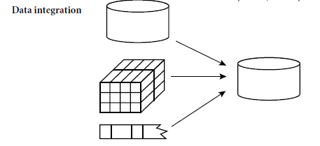
Data Integration
Data integration:
Combines data from multiple sources into a coherent store
Schema integration: e.g., A.cust-id ≡ B.cust-#
Integrate metadata from different sources
Entity identification problem:
Identify real world entities from multiple data sources,
e.g., Bill Clinton = William Clinton
Detecting and resolving data value conflicts
For the same real world entity, attribute values from different sources are different
Possible reasons: different representations, different scales, e.g., metric vs. British units
42

Slide 43
Handling Redundancy in Data Integration
Redundant data occur often when integration of multiple databases
Object identification: The same attribute or object may have different names in different databases
Derivable data: One attribute may be a “derived” attribute in another table, e.g., annual revenue
Redundant attributes may be able to be detected by correlation analysis and covariance analysis
Careful integration of the data from multiple sources may help reduce/avoid redundancies and inconsistencies and improve mining speed and quality
43

Slide 44
Correlation Analysis (Numeric Data)
Correlation coefficient (also called Pearson’s product moment coefficient)
where n is the number of tuples, and are the respective means of A and B, σ_{A} and σ_{B} are the respective standard deviation of A and B, and Σ(a_{i}b_{i}) is the sum of the AB cross-product.
If r_{A,B} > 0, A and B are positively correlated (A’s values increase as B’s). The higher, the stronger correlation.
r_{A,B} = 0: independent; r_{AB} < 0: negatively correlated

Slide 45
Exercise
Find the correlation between A1 and A2.
A1 | A2 | Class
10 | 650 | Yes
12 | 550 | No
15 | 200 | No
20 | 100 | Yes
14 | 350 | Yes
9 | 700 | Yes
5 | 900 | No
19 | 250 | No
17 | 200 | Yes
16 | 300 | Yes
=CORREL(A2:A11,B2:B11)

Slide 46
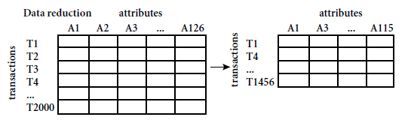
Data Reduction Strategies
Data reduction: Obtain a reduced representation of the data set that is much smaller in volume but yet produces the same (or almost the same) analytical results
Why data reduction? — A database/data warehouse may store terabytes of data. Complex data analysis may take a very long time to run on the complete data set.
Data reduction strategies
Dimensionality reduction, e.g., remove unimportant attributes
Wavelet transforms
Principal Components Analysis (PCA)
Feature subset selection, feature creation
Numerosity reduction (some simply call it: Data Reduction)
Regression and Log-Linear Models
Histograms, clustering, sampling
Data cube aggregation
Data compression

Slide 47
Data Reduction 1: Dimensionality Reduction
Curse of dimensionality
When dimensionality increases, data becomes increasingly sparse
Density and distance between points, which is critical to clustering, outlier analysis, becomes less meaningful
The possible combinations of subspaces will grow exponentially
Dimensionality reduction
Avoid the curse of dimensionality
Help eliminate irrelevant features and reduce noise
Reduce time and space required in data mining
Allow easier visualization
Dimensionality reduction techniques
Wavelet transforms
Principal Component Analysis
Supervised and nonlinear techniques (e.g., feature selection)
Notes:
47

Slide 48
Attribute Subset Selection
Another way to reduce dimensionality of data
Redundant attributes
Duplicate much or all of the information contained in one or more other attributes
E.g., purchase price of a product and the amount of sales tax paid
Irrelevant attributes
Contain no information that is useful for the data mining task at hand
E.g., students' ID is often irrelevant to the task of predicting students' GPA

Slide 49
Heuristic Search in Attribute Selection
There are 2^{d} possible attribute combinations of d attributes
Typical heuristic attribute selection methods:
Best single attribute under the attribute independence assumption: choose by significance tests
Best step-wise feature selection:
The best single-attribute is picked first
Then next best attribute condition to the first, ...
Step-wise attribute elimination:
Repeatedly eliminate the worst attribute
Best combined attribute selection and elimination
Optimal branch and bound:
Use attribute elimination and backtracking

Slide 50
The 2^{d} problem
Assume we have 5 attributes (A, B, C, D, E)

Slide 51
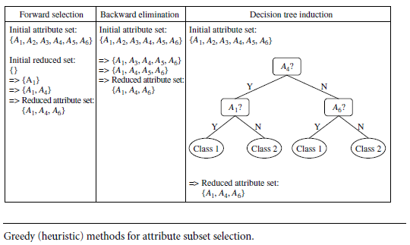
Heuristic Search in Attribute Selection

Slide 52
Attribute Creation (Feature Generation)
52
Create new attributes (features) that can capture the important information in a data set more effectively than the original ones
Three general methodologies
Attribute extraction
Domain-specific
Mapping data to new space (see: data reduction)
E.g., Fourier transformation, wavelet transformation, manifold approaches (not covered)
Attribute construction
Combining features
Data discretization
Notes:
52

Slide 53
Clustering
Partition data set into clusters based on similarity, and store cluster representation (e.g., centroid and diameter) only
Can be very effective if data is clustered but not if data is “smeared”
Can have hierarchical clustering and be stored in multi-dimensional index tree structures
There are many choices of clustering definitions and clustering algorithms
Wait until we cover the Cluster Analysis Topic

Slide 54
Sampling
Sampling: obtaining a small sample s to represent the
whole data set N (What)
Allow a mining algorithm to run in complexity that is potentially sub-linear to the size of the data (Why)
Key principle: Choose a representative subset of the data
Simple random sampling may have very poor performance in the presence of skew
Develop adaptive sampling methods, e.g., stratified sampling:
Note: Sampling may not reduce database I/Os (page at a time)

Slide 55
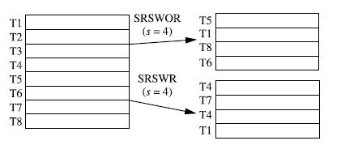
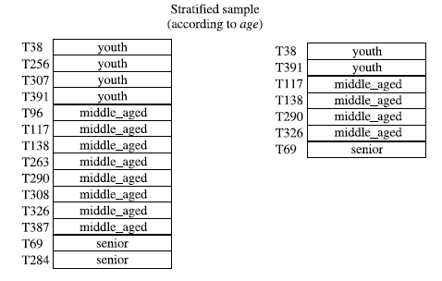
Types of Sampling Methods
Simple random sampling
There is an equal probability of selecting any particular item
Sampling without replacement
Once an object is selected, it is removed from the population
Sampling with replacement
A selected object is not removed from the population
Stratified sampling:
Partition the data set, and draw samples from each partition (proportionally, i.e., approximately the same percentage of the data)
Used in conjunction with skewed data
Example
Example

Slide 56
Data Reduction 3: Data Compression
String compression
There are extensive theories and well-tuned algorithms
Typically lossless, but only limited manipulation is possible without expansion
Audio/video compression
Typically lossy compression, with progressive refinement
Sometimes small fragments of signal can be reconstructed without reconstructing the whole
Time sequence is not audio
Typically short and vary slowly with time
Note: Dimensionality and numerosity reduction may also be considered as forms of data compression
Notes:
56

Slide 57
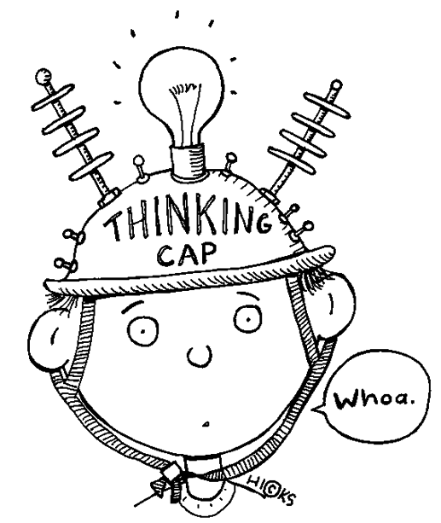


Think, Remember, and Discuss
Lossy vs Lossless Techniques
General Purpose vs Special Purpose Techniques
Domain specific methods: Medical, Financial ….
Name some Tools : WinRar, WinZip, Compress, …..
Note: This topic is well covered in CIS 280 and CIS 256 Courses.

Slide 58
Data Compression
Original Data
Compressed
Data
lossless
Original Data
Approximated
lossy
Notes:
58

Slide 59
Data Transformation
A function that maps the entire set of values of a given attribute to a new set of replacement values such that each old value can be identified with one of the new values
Methods
Smoothing: Remove noise from data
Attribute/feature construction
New attributes constructed from the given ones
Aggregation: Summarization, data cube construction
Normalization: Scaled to fall within a smaller, specified range
min-max normalization
z-score normalization
normalization by decimal scaling
Discretization: Concept hierarchy climbing
Notes:
59

Slide 60
Normalization
Min-max normalization: to [new_min_{A}, new_max_{A}]
Ex. Let income range $12,000 to $98,000 normalized to [0.0, 1.0]. Then $73,600 is mapped to
Z-score normalization (μ: mean, σ: standard deviation):
Ex. Let μ = 54,000, σ = 16,000. Then
Normalization by decimal scaling
Where j is the smallest integer such that Max(|ν’|) < 1
Optional Assignment: Write a program that implement these methods.

Slide 61
Exercise
Income
15500
20000
24000
23000
12000
73600
45000
98000
78000
62000
Min-Max | Z-Score | Dec Scale j=2 | Dec Scale j=3
0.041 | -0.963 | 155.00 | 15.50
0.093 | -0.816 | 200.00 | 20.00
0.14 | -0.686 | 240.00 | 24.00
0.128 | -0.719 | 230.00 | 23.00
0 | -1.076 | 120.00 | 12.00
0.716 | 0.926 | 736.00 | 73.60
0.384 | -0.004 | 450.00 | 45.00
1 | 1.72 | 980.00 | 98.00
0.767 | 1.069 | 780.00 | 78.00
0.581 | 0.549 | 620.00 | 62.00
Normalize
New Min = | 0
New Max = | 1
Min = | 12000
Max = | 98000
Mean = | 45110
SD = | 30757.27376
Note: This table has been generated using MS-Excel.

Slide 62
Discretization
Three types of attributes
Nominal—values from an unordered set, e.g., color, profession
Ordinal—values from an ordered set, e.g., military or academic rank
Numeric—real numbers, e.g., integer or real numbers
Discretization: Divide the range of a continuous attribute into intervals
Interval labels can then be used to replace actual data values
Reduce data size by discretization
Supervised vs. unsupervised
Split (top-down) vs. merge (bottom-up)
Discretization can be performed recursively on an attribute
Prepare for further analysis, e.g., classification

Slide 63
Data Discretization Methods
Typical methods: All the methods can be applied recursively
Binning
Top-down split, unsupervised
Histogram analysis
Top-down split, unsupervised
Clustering analysis (unsupervised, top-down split or bottom-up merge)
Decision-tree analysis (supervised, top-down split)
Correlation (e.g., χ²) analysis (unsupervised, bottom-up merge)
63
Notes:
63

Slide 64
Simple Discretization: Binning
Equal-width (distance) partitioning
Divides the range into N intervals of equal size: uniform grid
if A and B are the lowest and highest values of the attribute, the width of intervals will be: W = (B –A)/N.
The most straightforward, but outliers may dominate presentation
Skewed data is not handled well
Equal-depth (frequency) partitioning
Divides the range into N intervals, each containing approximately same number of samples (frequency = size of the interval).
Good data scaling
Managing categorical attributes can be tricky

Slide 65
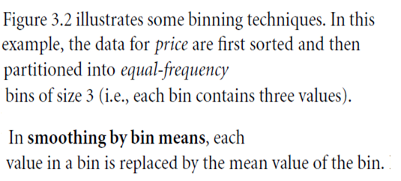
Example: Binning using equal Frequency Method

Slide 66
Concept Hierarchy Generation

Slide 67
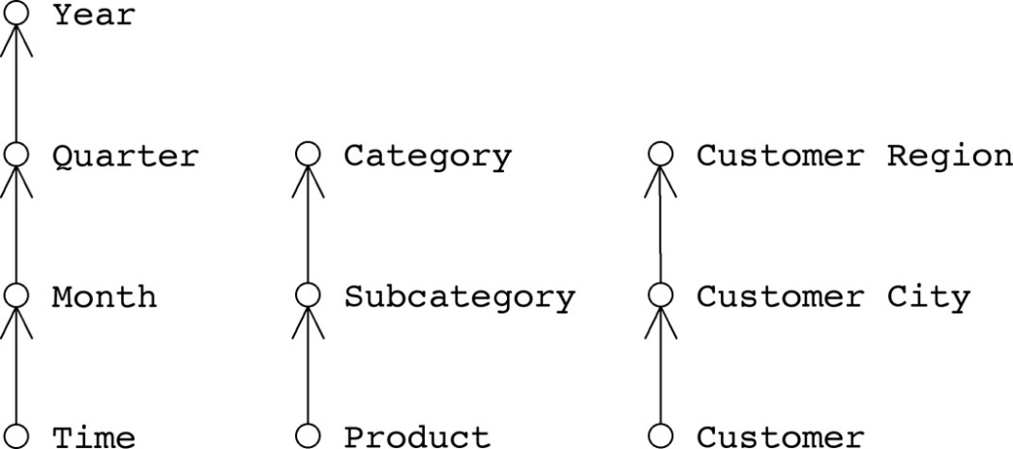
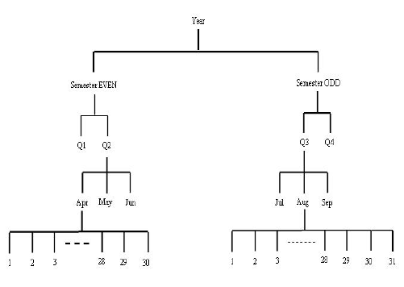
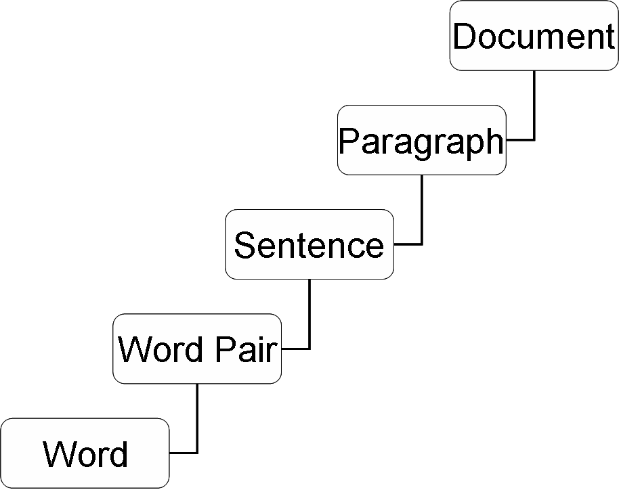
Concept Hierarchy: Examples

Slide 68
Concept Hierarchy Generation
Concept hierarchy organizes concepts (i.e., attribute values) hierarchically and is usually associated with each dimension in a data warehouse
Concept hierarchies facilitate drilling and rolling in data warehouses to view data in multiple granularity.
Concept hierarchy formation: Recursively reduce the data by collecting and replacing low level concepts (such as numeric values for age) by higher level concepts (such as youth, adult, or senior)
Concept hierarchies can be explicitly specified by domain experts and/or data warehouse designers
Concept hierarchy can be automatically formed for both numeric and nominal data. For numeric data, use discretization methods shown.

Slide 69
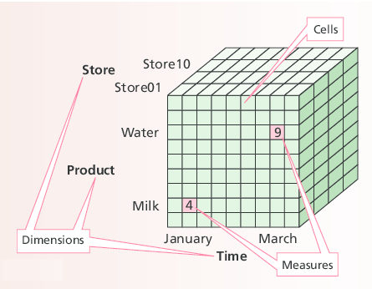
Reminder: Data Cup

Slide 70
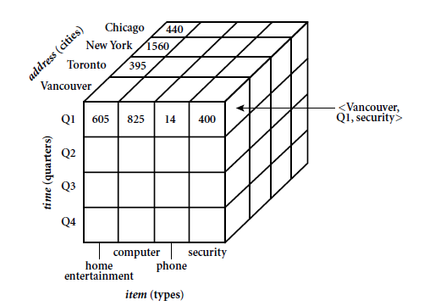
An Example of a Data Cube

Slide 71
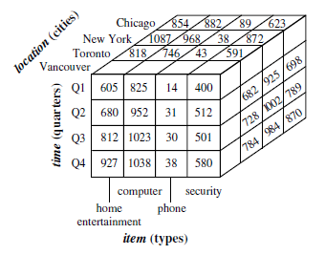
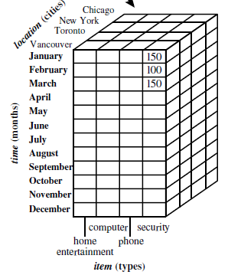

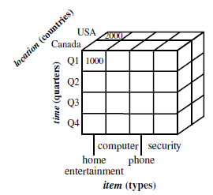
























An Example of a Data Cube

Slide 72
Concept Hierarchy Generation for Nominal Data
Specification of a partial/total ordering of attributes explicitly at the schema level by users or experts
street < city < state < country
Specification of a hierarchy for a set of values by explicit data grouping
{Urbana, Champaign, Chicago} < Illinois
Specification of only a partial set of attributes
E.g., only street < city, not others
Automatic generation of hierarchies (or attribute levels) by the analysis of the number of distinct values
E.g., for a set of attributes: {street, city, state, country}

Slide 73
Automatic Concept Hierarchy Generation
Some hierarchies can be automatically generated based on the analysis of the number of distinct values per attribute in the data set
The attribute with the most distinct values is placed at the lowest level of the hierarchy
Exceptions, e.g., weekday, month, quarter, year
country
15 distinct values
province_or_ state
365 distinct values
city
3567 distinct values
street
674,339 distinct values

Slide 74
WEKA
See this page:
http://facweb.cs.depaul.edu/mobasher/classes/ect584/weka/preprocess.html
Watch this Video:
http://facweb.cs.depaul.edu/mobasher/classes/ect584/WEKA/preprocessing_with_weka.html

Slide 75
Summary
Data attribute types: nominal, binary, ordinal, interval-scaled, ratio-scaled
Many types of data sets, e.g., numerical, text, graph, Web, image.
Gain insight into the data by:
Basic statistical data description: central tendency, dispersion, graphical displays
Data visualization: map data onto graphical primitives
Measure data similarity
Above steps are the beginning of data preprocessing.
Many methods have been developed but still an active area of research.

Slide 76
Summary
Data quality: accuracy, completeness, consistency, timeliness, believability, interpretability
Data cleaning: e.g. missing/noisy values, outliers
Data integration from multiple sources:
Entity identification problem
Remove redundancies
Detect inconsistencies
Data reduction
Dimensionality reduction
Numerosity reduction
Data compression
Data transformation and data discretization
Normalization
Concept hierarchy generation

Slide 77
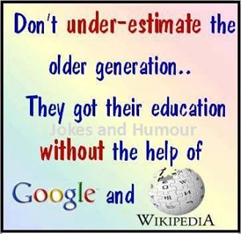


Relax and Think

